Slide 1
SECURE DATA HIDING IN IMAGE USIN STENOGRAPHY
SECURE THE DATA TO PREVENT HACKERS
Presented By: Baig Fatema.
Student Name : Baig Fatema.
College Name & Department : SBES College of science Abad.
CS department.

Slide 2
OUTLINE
Problem Statement
Technology used
Wow factor
End users
Result
Conclusion
Git-hub Link
Future scope

Slide 3
Problem Statement
In today's digital world, secure communication is essential to protect sensitive information from unauthorized access. Traditional encryption methods can attract attention, making hidden communication difficult. This project explores steganography, a technique that conceals secret messages within an image by modifying pixel values. The system ensures message encryption and decryption with a password, adding an extra layer of security. This method provides a discreet and efficient way to transmit confidential data without raising suspicion.

Slide 4
Technology used
This Steganography Project is implemented in Python using the OpenCV (cv2) library for image processing and OS module for system operations. The project runs on Windows/Linux platforms and utilizes ASCII encoding to embed secret messages within pixel values of an image. A password-based decryption mechanism ensures restricted access to the hidden data. The encrypted image is stored and can be retrieved using the correct passcode. This method enables secure and hidden communication without drawing suspicion.

Slide 5
Wow factors
Unique Features of This Project
Steganography-Based Encryption – Unlike traditional encryption, this project hides messages within image pixels, making the data invisible to outsiders. Password-Protected Decryption – Only users with the correct passcode can retrieve the hidden message, adding an extra layer of security. Lightweight & Efficient – Uses simple ASCII encoding without significantly altering the image quality or size. Cross-Platform Compatibility – Runs smoothly on Windows & Linux using Python, OpenCV, and OS modules. No External Storage Needed – The message is embedded within the image itself, eliminating the need for additional storage files. User-Friendly Execution – The project is easy to use with simple input prompts for encryption and decryption, requiring no advanced technical knowledge. 🚀

Slide 6
End users
End Users of This Project
Cybersecurity Professionals – Can use this technique for covert communication and data protection.
Journalists & Whistleblowers – Helps safely transmit sensitive information without raising suspicion.
Government & Intelligence Agencies – Useful for secure and classified communication
Researchers & Academicians – Can explore steganography applications in digital security.
Individuals Concerned About Privacy – Enables personal message encryption for secure exchanges.
Developers & Ethical Hackers – Helps understand and implement hidden data transmission techniques. 🚀

Slide 7
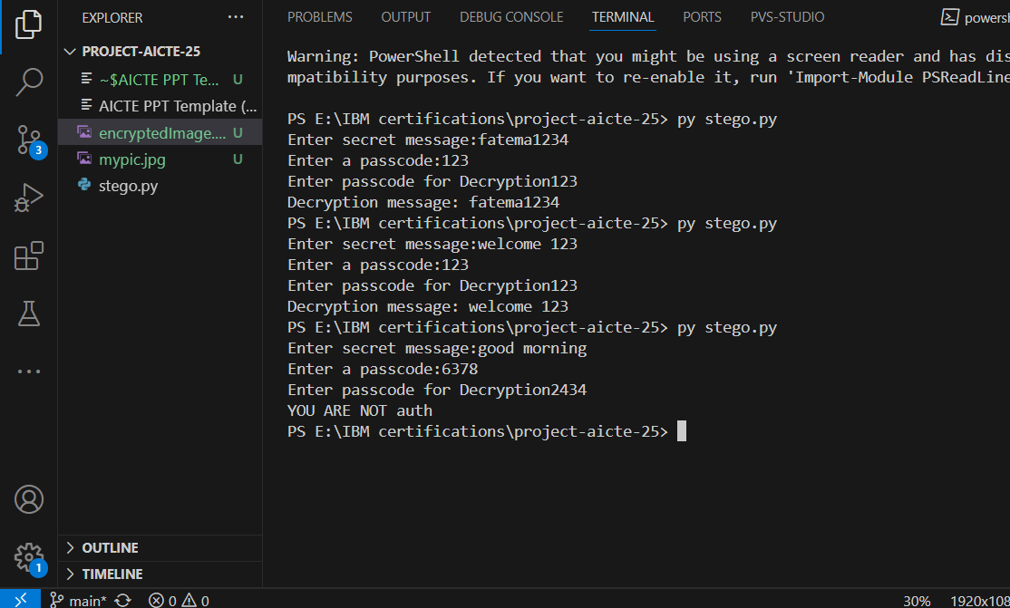
Results

Slide 8
Conclusion
communication by embedding secret messages within images. Unlike traditional encryption, this method keeps the data invisible, making it less likely to attract attention. The password-protected decryption ensures that only authorized users can access the hidden information, enhancing security. The project is lightweight, cross-platform compatible, and easy to implement, making it a valuable tool for cybersecurity professionals, journalists, and privacy-conscious users. By leveraging image-based encryption, this project provides a discreet and efficient way to protect sensitive information in the digital world.

Slide 9
GitHub Link
https://github.com/Baig-fatema/AICTE_2025_Edunet_Stego_Project

Slide 10
Future scope(optional)
Enhanced Encryption Techniques – Implementing advanced cryptographic methods alongside steganography for added security.
Support for Multiple File Types – Expanding functionality to hide messages in audio, video, and text files instead of just images.
Increased Capacity – Optimizing pixel manipulation techniques to store larger messages without affecting image quality.
AI-Based Detection Prevention – Developing AI algorithms to make hidden messages undetectable by steganalysis tools
Cloud Integration – Enabling secure storage and retrieval of stego images over cloud platforms.
Mobile & Web Applications – Creating user-friendly apps for seamless encryption and decryption on smartphones and web browsers. 🚀

Slide 11
THANK YOU

